Slide 1
Chemical Vapour Deposition

Slide 2
Four Main CVD Techniques
LPCVD - Low pressure CVD
  Polysilicon, silicon nitride and tungsten deposition
PECVD - Plasma Enhanced CVD
  Silicon dioxide, PSG, BPSG, Silicon Nitride
APCVD - Atmospheric pressure CVD
  Silicon dioxide, BPSG, PSG
EPITAXY
  Deposition of single crystal silicon

Slide 3
LPCVD
The main processes run in LPCVD reactors are :
  Polysilicon
  Silicon Nitride
  Silicon Dioxide
Of these Polysilicon and Silicon Nitride are the most common.

Slide 4
FURNACE SET-UP
Gas Control
Gas Inlet
Sealed Door
Extract
Vacuum
Pump

Slide 5
Polysilicon
Polysilicon is an “insulator” (high resistance) as deposited
It becomes a conductor when doped with a dopant such as phosphorous
The most common use of polysilicon in the semiconductor industry is as a gate electrode in a CMOS process
It is also used as a first level conductor in a MOS process

Slide 6
Chemistry
The chemical process to deposit polysilicon is one of the simplest of the LPCVD processes
SiH₄ --------------> Si + 2H₂
600ºC
The decomposition of the gas, silane, at a temp of about 600ºC gives these by-products
  Silicon deposited as polycrystaline silicon and Hydrogen taken away in the pumping system
The process can either use dilute silane or pure silane

Slide 7
Polysilicon Deposition
Polysilicon is deposited as polycrystalline film at temperatures of 600ºC to 650ºC.
Below 600ºC the deposition is called amorphous or pseudo amorphous
Films deposited as amorphous can be recrystallised by an anneal subsequent to the deposition
The deposition rate is dependant on the temperature in an exponential relationship

Slide 8
Polysilicon Structure
Grain size can be varied by changing dep and anneal temperatures
In modern CMOS processes often combined with refractory metals to form silicides
  Titanium - TiSi₂
Polysilicon
Titanium
Silicide

Slide 9
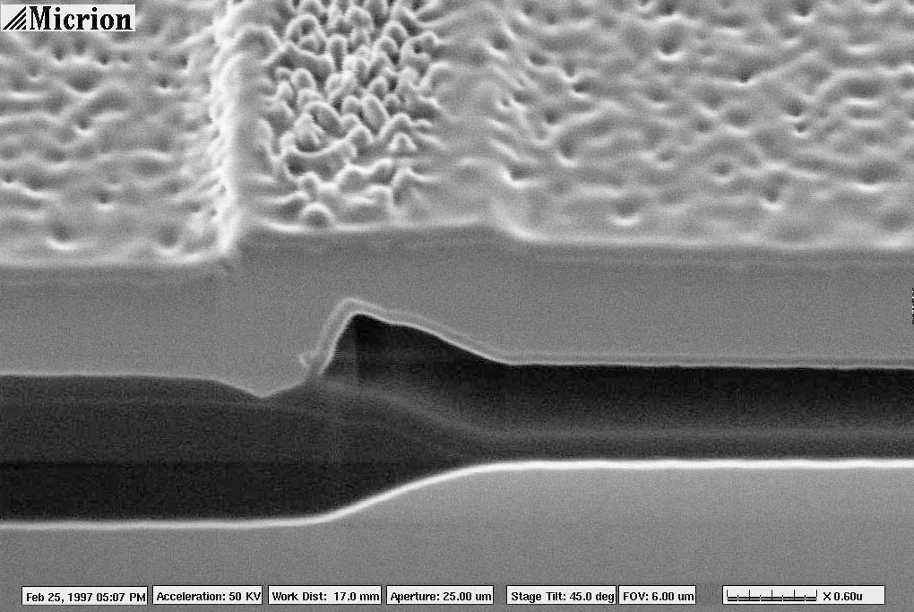
Polysilicon Surface Micromachining
A material used in surface micromachining
In NMRC as a pressure sensor and as a bolometer table
Pressure Sensor

Slide 10
Silicon Nitride
Can be deposited as a LPCVD film or a PECVD film
LPCVD films are of a stoichiometric composition with a high film density (between 2.9 - 3.1 g/cm³)
LPCVD Silicon Nitride is very useful as a barrier layer for numerous applications and provides a very good barrier to sodium penetration.
LPCVD Silicon Nitride acts as a barrier to oxide growth in the LOCOS process

Slide 11
Chemistry
Silicon nitride in LPCVD reactions is formed from the thermal decomposition of dichlorosilane and ammonia
3SiCl₂H₂ + 4NH₃ ----------> Si₃N₄ + 6HCl + 6H₂
700ºC
Silicon Nitride is deposited as a solid on all surfaces in the hot wall reaction chamber
Hydrogen chloride and hydrogen are pumped away as by-products

Slide 12
LPCVD Nitride in Process
Nitride in the CMOS active areas to prevent Field Oxidation (FOX)
Used as a masking material for KOH etching
A gate dielectric material for ISFET applications

Slide 13
LOCOS or Semi Recessed Oxide
Silicon
Deposit Silicon Nitride
Grow Thin Oxide
Pattern with
Photoresist

Slide 14
Etch unprotected
nitride
Remove the Resist
Leaving nitride pad
on thin oxide

Slide 15
Grow the field oxide
Original thin oxide
Nitride forced up
at edges by
encroaching oxide
Active
Field Area
Area
Birds
Beak
Structure

Slide 16
Plasma Enhanced CVD
Electrode
Shower head
Plasma
RF
Wafer
Electrode
R.F. energy is used to excite gases and initiate the reaction
The main advantage of this is that deposition can be performed at low temperatures 300 - 400ºC
Because of the low deposition temp PECVD is particularly useful after metal deposition
[temp must be kept below 450ºC]

Slide 17
Plasma Deposition
H
Si
O₂
SiO₂
Plasma deposition consists of exciting a gas so that it will react with itself or another gas
Plasma deposition systems are basically the same as etch etch systems but different types of gas are used
It is essential that the gases used in plasma deposition do not react spontaneously

Slide 18
Plasma Silicon Dioxide
SiH₄ + 2N₂O -----> SiO₂ + 2H₂ + 2N₂
Silane and nitrous oxide react to give silicon dioxide at a deposition temperature of 300 - 400ºC
These oxides can be doped by using phosphine and diborane
Plasma oxides are generally poorer quality than thermally grown or LPCVD oxides
Plasma oxides tend to contain large amounts of hydrogen (>12 wt%) due to incomplete dissociation of silane
Step coverage tends to be mediocre

Slide 19
Variations
BPSG, plasma deposited silicon dioxide with a percentage of boron and phosphorus incorporated
  BoroPhosphoSilicate Glass
The BPSG becomes “plastic” at high temperatures in the presence of steam and can be reflowed

Slide 20
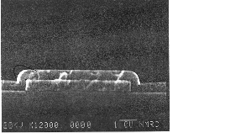

Slide 21
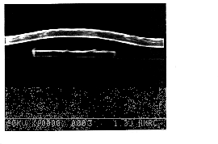

Slide 22
Plasma Silicon Nitride
SiH₄ + NH₃ + N₂ -----> Si_{x}N_{y}(H)
Silicon nitride films are deposited by the reaction of silane, ammonia and nitrogen
Deposition temperature is 300 - 350ºC
These films have found widespread use as final passivation films since they are good barriers to moisture and ionic contamination
Plasma nitride films also have large amounts of hydrogen (>20 wt%)

Slide 23
Plasma Silicon Oxynitride
SiH₄ +NH₃ + N₂O -------> Si_{x}O_{y}N_{z}(H)
Used in certain applications where the properties required are somewhere between that of nitride and oxide
For example where the process requires the optical properties of oxide and the barrier properties of nitride

Slide 24
Plasma Oxide/Oxynitride in Process
Poly-metal dielectric
Interlevel metal dielectric
Waveguide material
Masking material for implant or etch
Doped with phosphorus as a passivation material
Layered Oxide Structure
Optic Fibre

Slide 25
PECVD TEOS
Si(OC₂H₅)₄ ------> SiO₂ + by-products
PECVD TEOS is popular because of the excellent step coverage
Quality of the oxides tends to be superior to silane based oxides

Slide 26
Atmospheric CVD
Formerly extensively used method for inter-level dielectric and passivation
Disappeared because of particulate deposition
Return as the “Watkins Johnson” APCVD system
Now ASML

Slide 27
CVD Tungsten
First level contacts often filled with CVD tungsten
Generally called a tungsten plug process
Eliminates Al contact fill problems
WF₆ +3H₂ W + 6HF
High aspect ratio contact hole
CVD tungsten deposition
Tungsten etch back

Slide 28
Epitaxial Layers
Growing extra silicon layers on top of the existing crystal
The new layer takes up the crystal structure of the underlying layers/substrate
The type and/or doping concentration can be changed

Slide 29
Layer Growth
Epitaxial Layer
Substrate

Slide 30
Bipolar Epitaxial Use
Bipolar processes traditionally use epi wafers
This is to enable the formation of a buried layer
Buried reduces the collector resistance
P
N
N
N
High collector
resistance
P
N
N
N
Buried Layer

Slide 31
CMOS Epitaxial Layers
Epi layers traditionally not used in MOS processes
With very small geometry processes it has become the norm
The structure or “P on P+” or “N on N+” helps prevent “latch-up”
P- Well
N- Well
N-Channel
P-Channel

